Slide 1

Murach’s C# 2010, C4
© 2010, Mike Murach & Associates, Inc.
Slide <number>

Slide 2
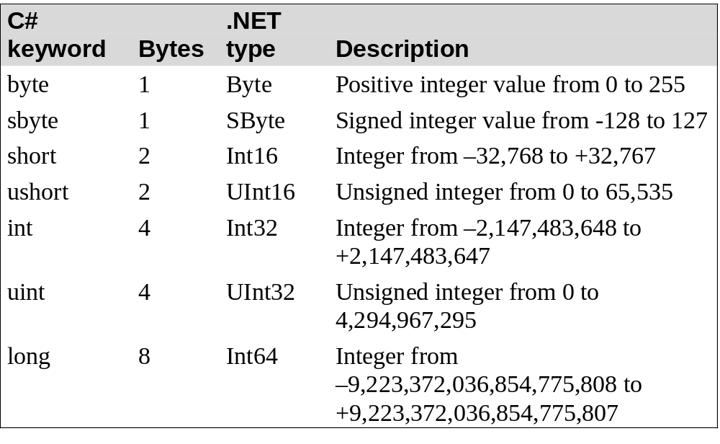
Murach’s C# 2010, C4
© 2010, Mike Murach & Associates, Inc.
Slide <number>

Slide 3
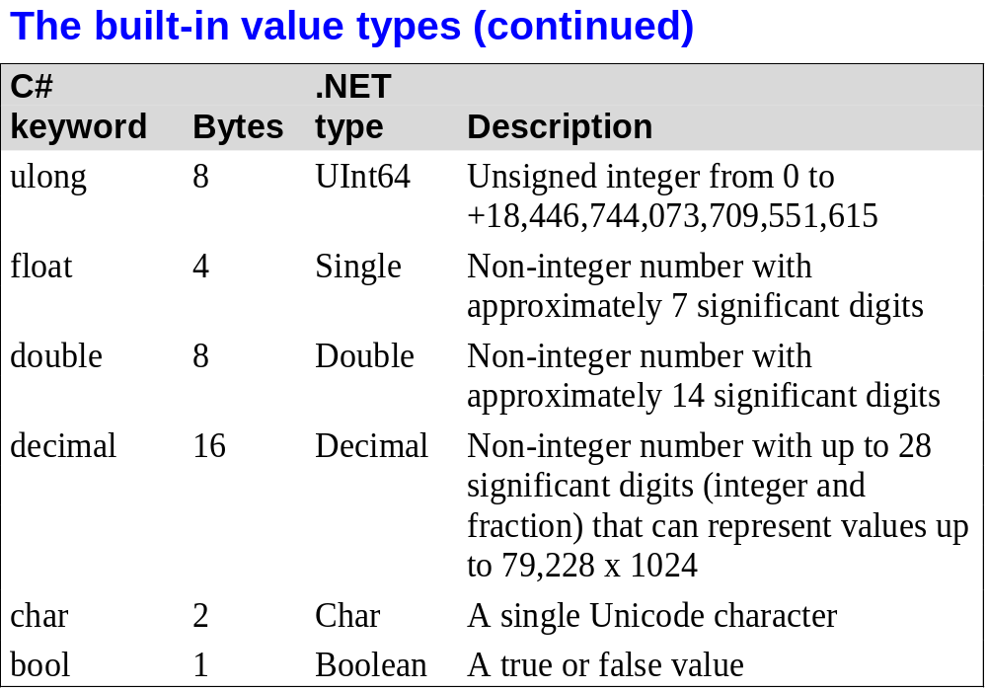
Murach’s C# 2010, C4
© 2010, Mike Murach & Associates, Inc.
Slide <number>

Slide 4
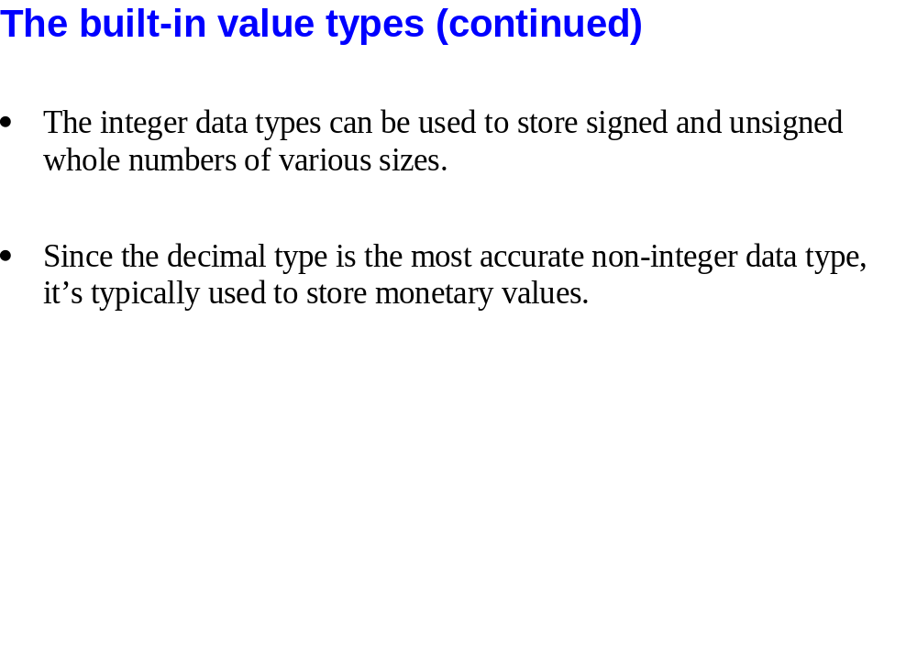
Slide <number>

Slide 5
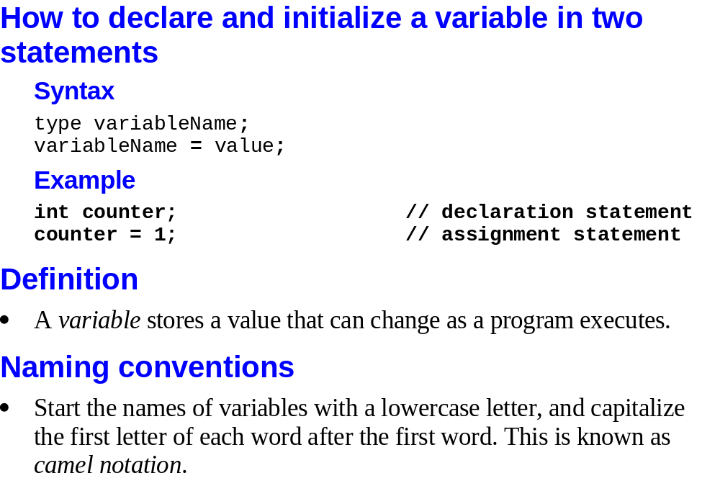
Murach’s C# 2010, C4
© 2010, Mike Murach & Associates, Inc.
Slide <number>

Slide 6
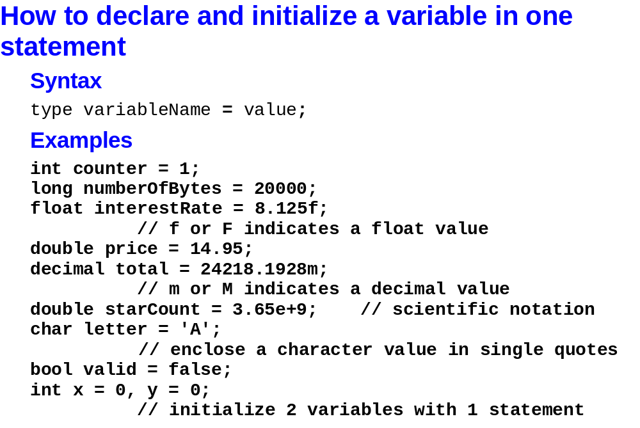
Murach’s C# 2010, C4
© 2010, Mike Murach & Associates, Inc.
Slide <number>

Slide 7
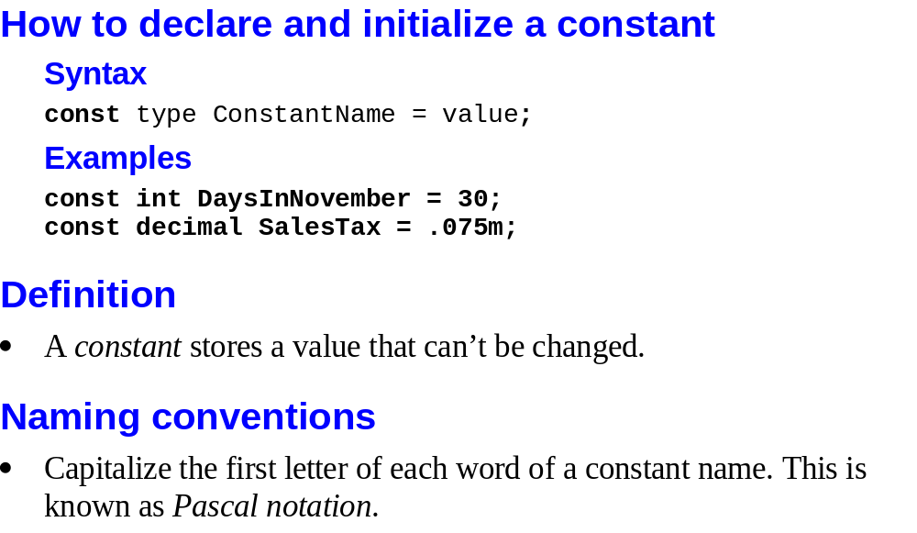
Murach’s C# 2010, C4
© 2010, Mike Murach & Associates, Inc.
Slide <number>

Slide 8
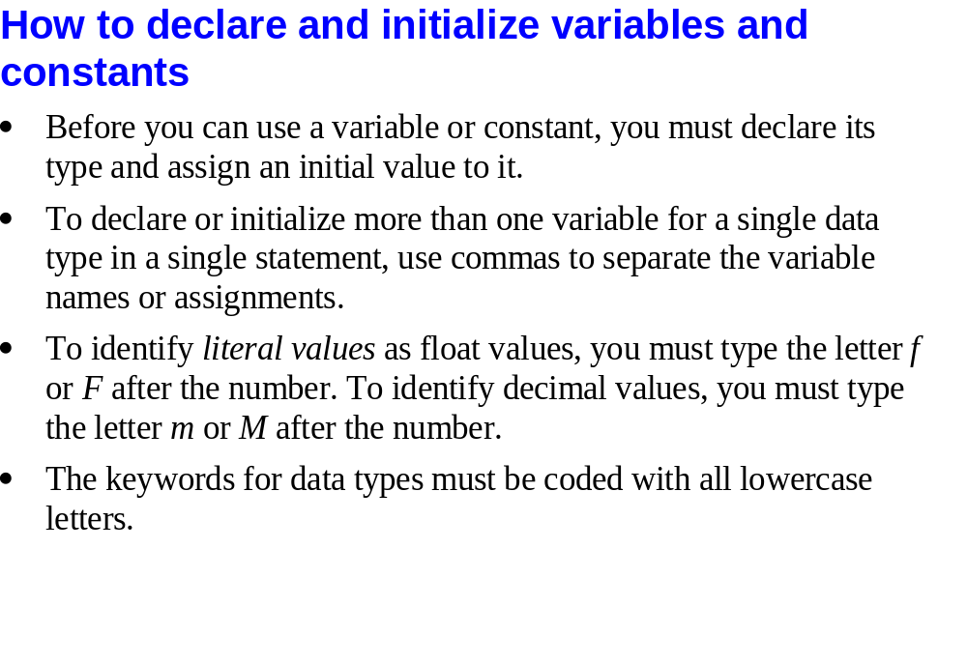
Slide <number>

Slide 9
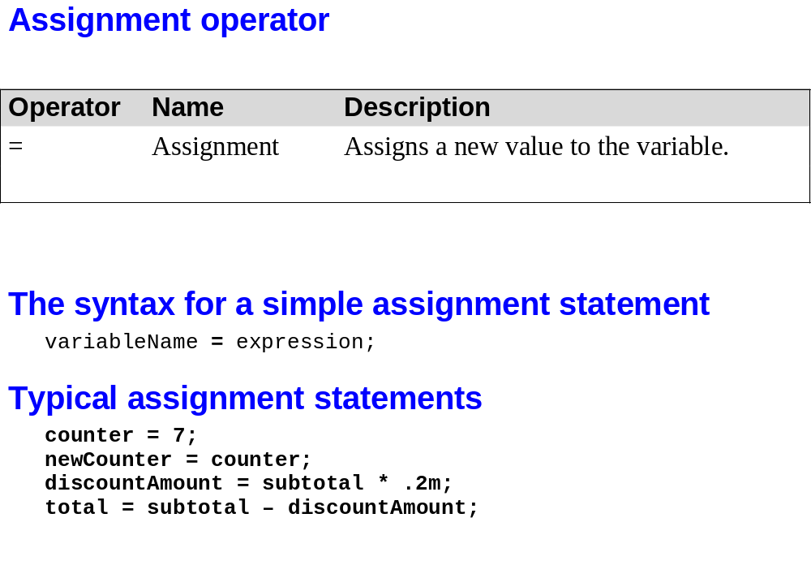
Slide <number>

Slide 10
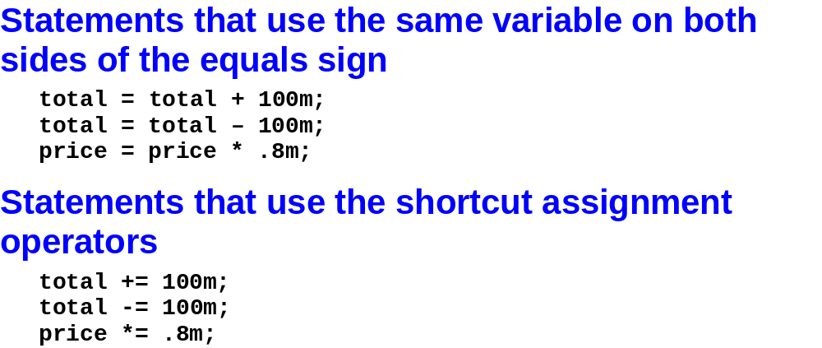
Murach’s C# 2010, C4
© 2010, Mike Murach & Associates, Inc.
Slide <number>

Slide 11
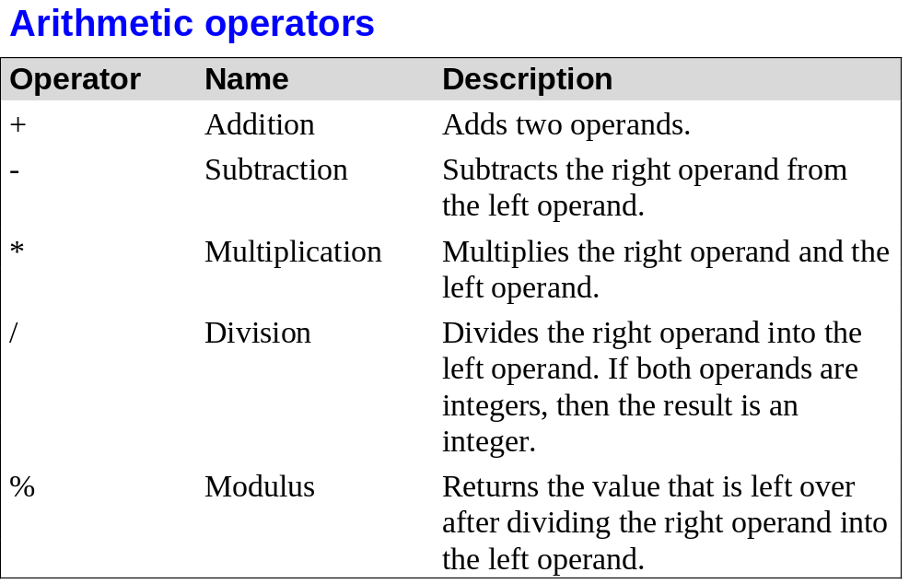
Murach’s C# 2010, C4
© 2010, Mike Murach & Associates, Inc.
Slide <number>

Slide 12
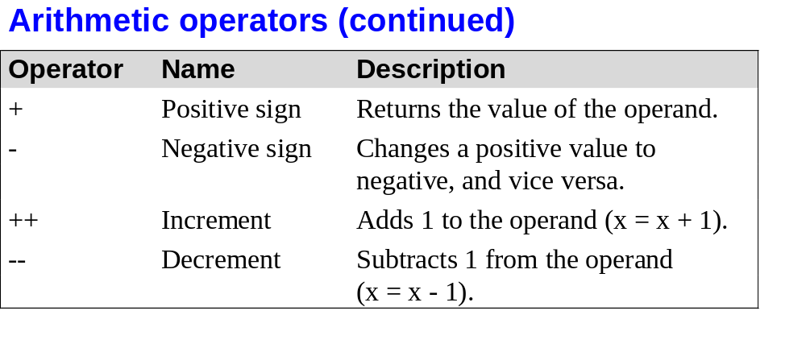
Murach’s C# 2010, C4
© 2010, Mike Murach & Associates, Inc.
Slide <number>

Slide 13
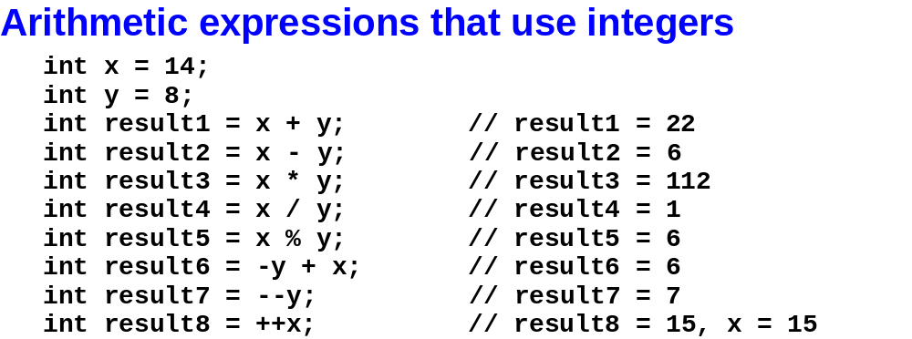
Murach’s C# 2010, C4
© 2010, Mike Murach & Associates, Inc.
Slide <number>

Slide 14
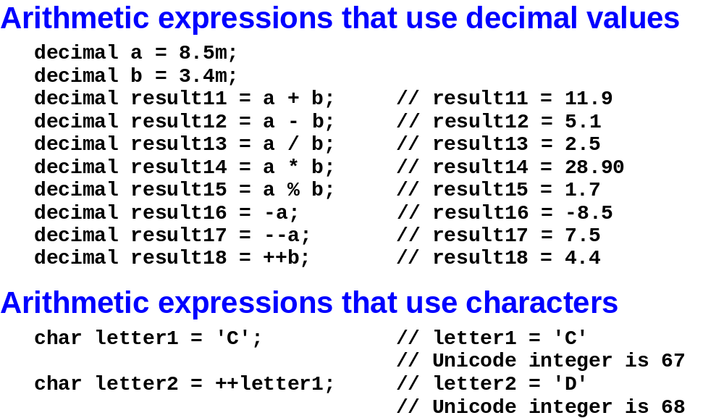
Murach’s C# 2010, C4
© 2010, Mike Murach & Associates, Inc.
Slide <number>

Slide 15
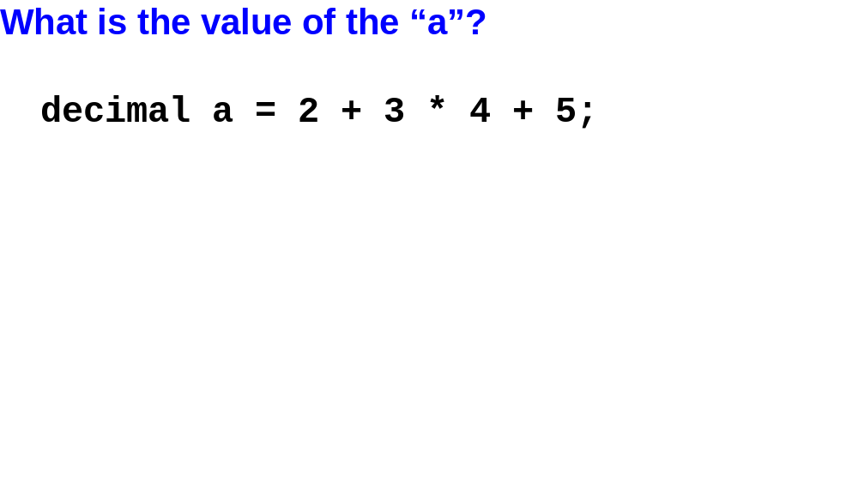
Slide <number>

Slide 16
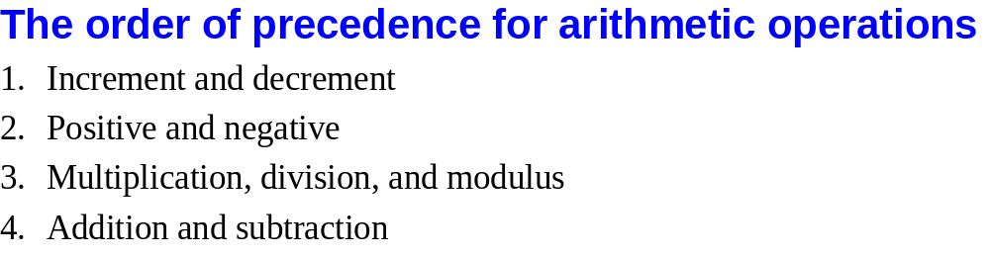
Murach’s C# 2010, C4
© 2010, Mike Murach & Associates, Inc.
Slide <number>

Slide 17
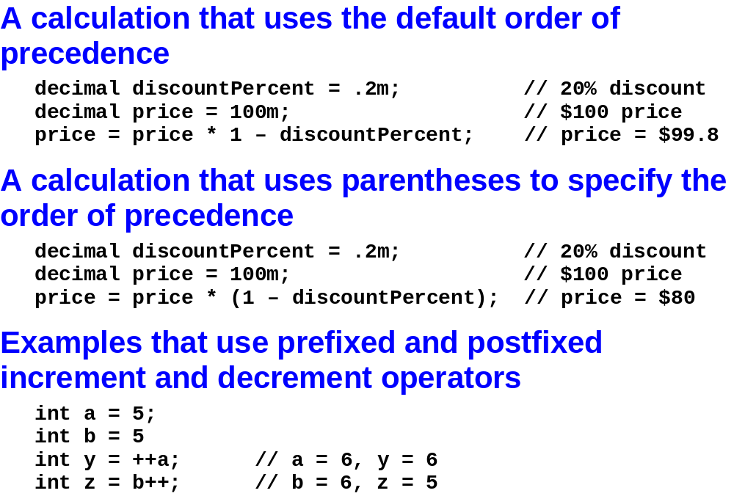
Murach’s C# 2010, C4
© 2010, Mike Murach & Associates, Inc.
Slide <number>

Slide 18
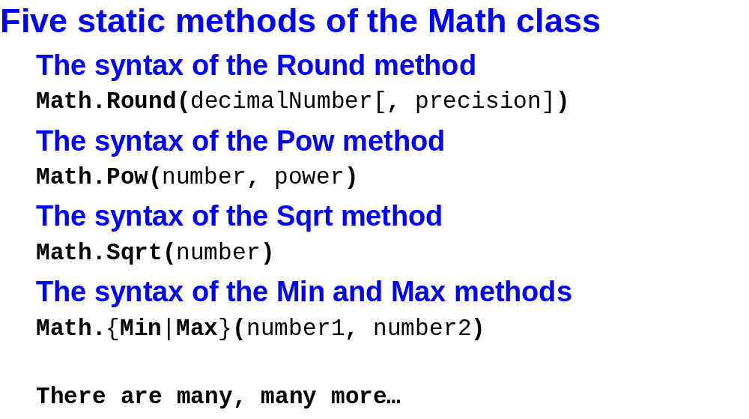
Murach’s C# 2010, C4
© 2010, Mike Murach & Associates, Inc.
Slide <number>

Slide 19
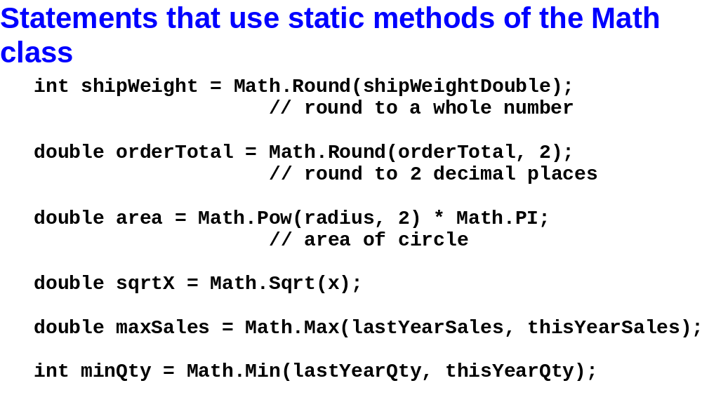
Murach’s C# 2010, C4
© 2010, Mike Murach & Associates, Inc.
Slide <number>

Slide 20
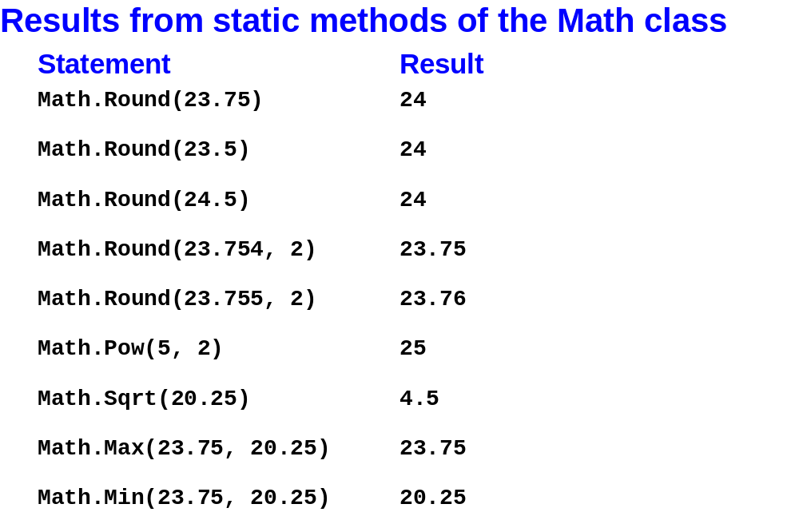
Murach’s C# 2010, C4
© 2010, Mike Murach & Associates, Inc.
Slide <number>

Slide 21
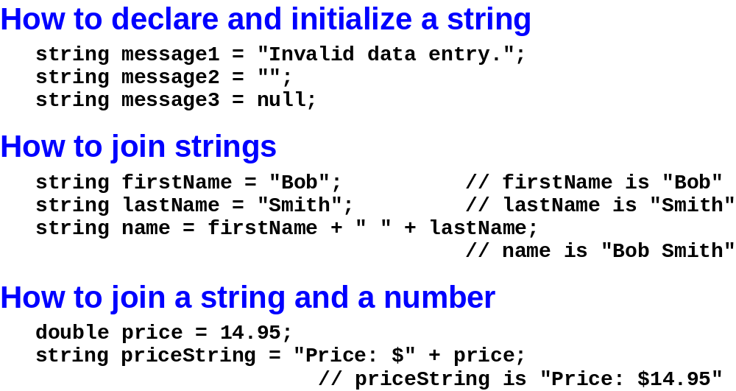
Murach’s C# 2010, C4
© 2010, Mike Murach & Associates, Inc.
Slide <number>

Slide 22
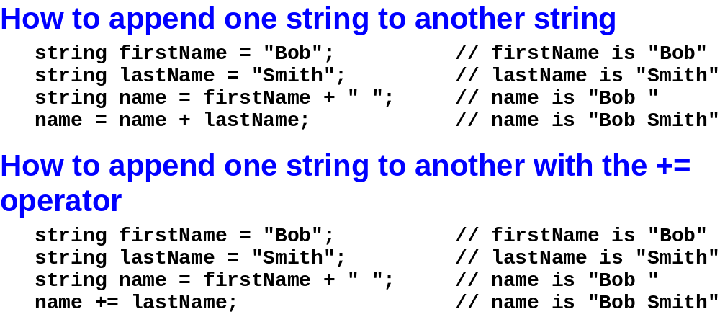
Murach’s C# 2010, C4
© 2010, Mike Murach & Associates, Inc.
Slide <number>

Slide 23
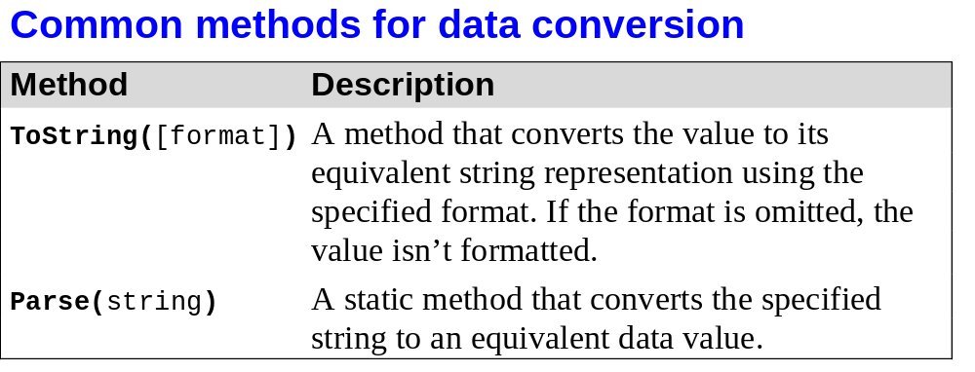
Murach’s C# 2010, C4
© 2010, Mike Murach & Associates, Inc.
Slide <number>

Slide 24
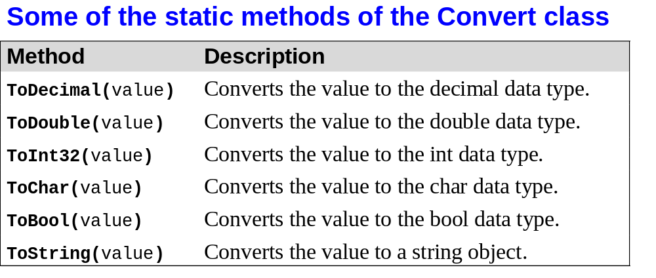
Murach’s C# 2010, C4
© 2010, Mike Murach & Associates, Inc.
Slide <number>

Slide 25
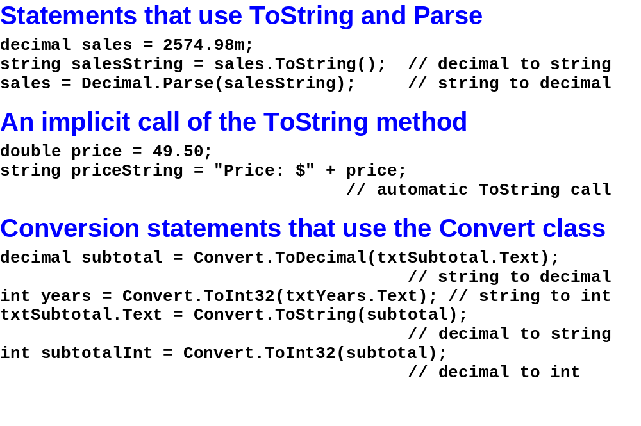
Murach’s C# 2010, C4
© 2010, Mike Murach & Associates, Inc.
Slide <number>

Slide 26
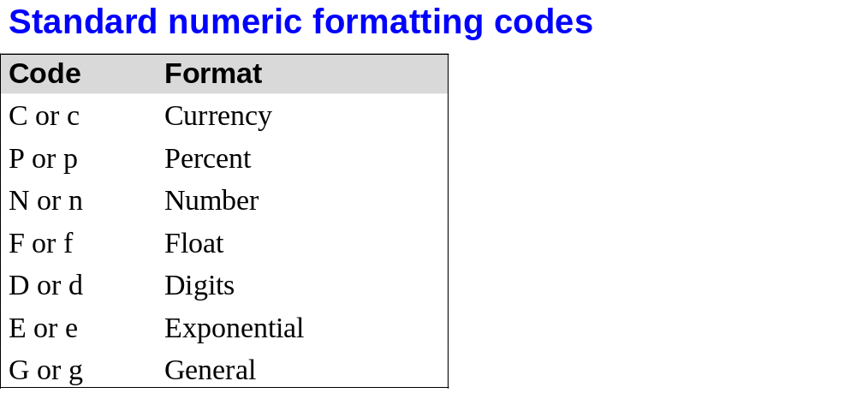
Murach’s C# 2010, C4
© 2010, Mike Murach & Associates, Inc.
Slide <number>

Slide 27
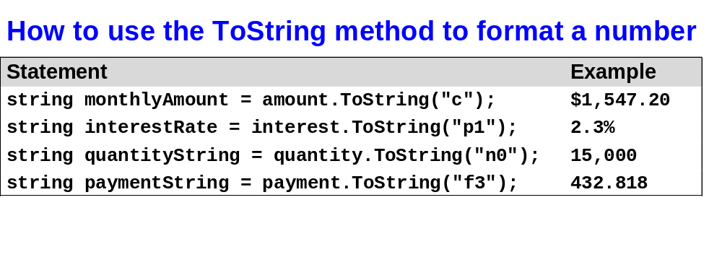
Murach’s C# 2010, C4
© 2010, Mike Murach & Associates, Inc.
Slide <number>

Slide 28
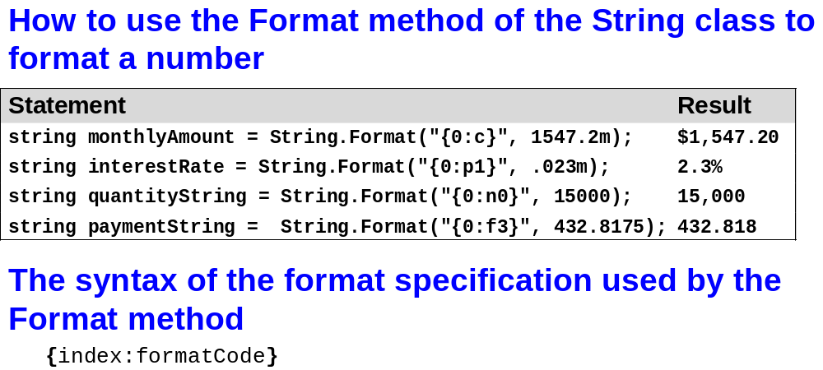
Murach’s C# 2010, C4
© 2010, Mike Murach & Associates, Inc.
Slide <number>

Slide 29
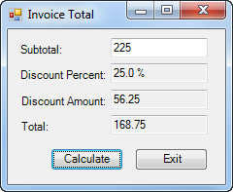
Murach’s C# 2010, C4
© 2010, Mike Murach & Associates, Inc.
Slide <number>

Slide 30
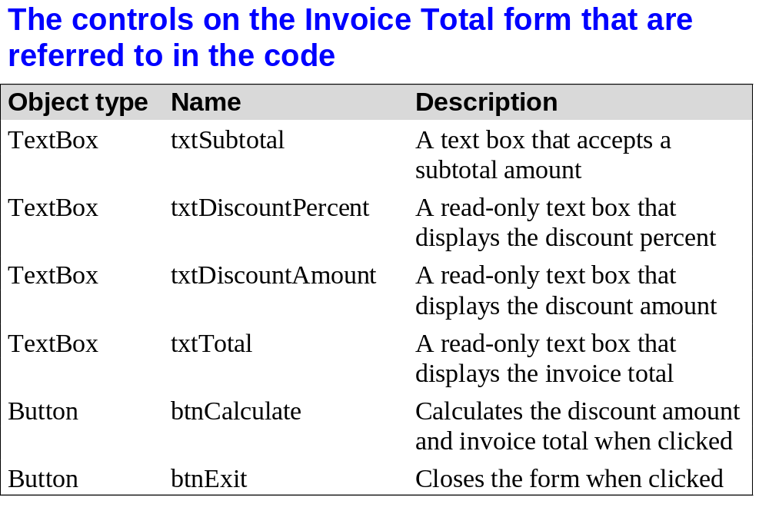
Murach’s C# 2010, C4
© 2010, Mike Murach & Associates, Inc.
Slide <number>

Slide 31
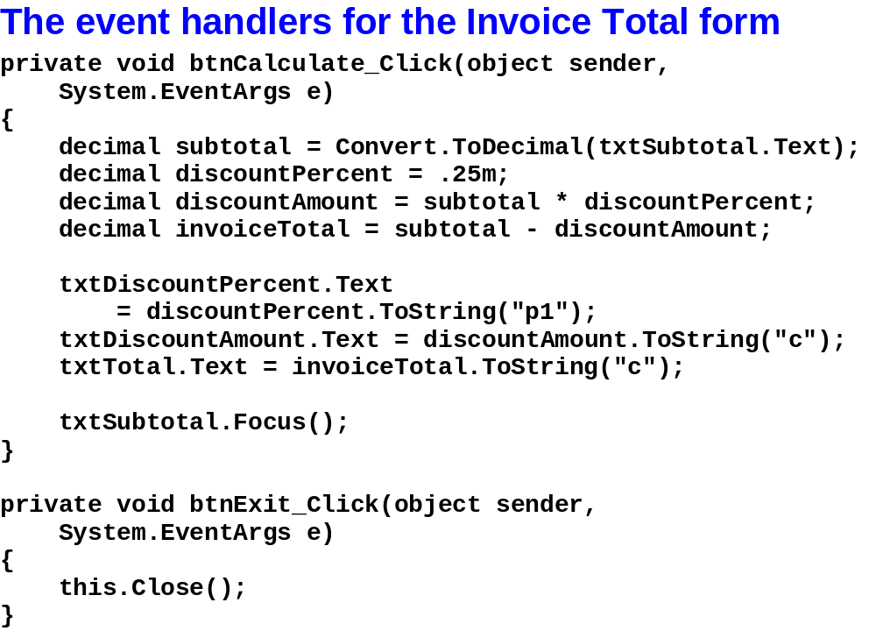
Murach’s C# 2010, C4
© 2010, Mike Murach & Associates, Inc.
Slide <number>

Slide 32
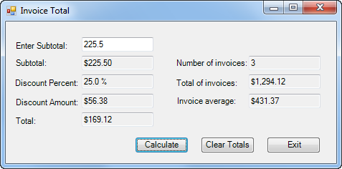
Murach’s C# 2010, C4
© 2010, Mike Murach & Associates, Inc.
Slide <number>

Slide 33
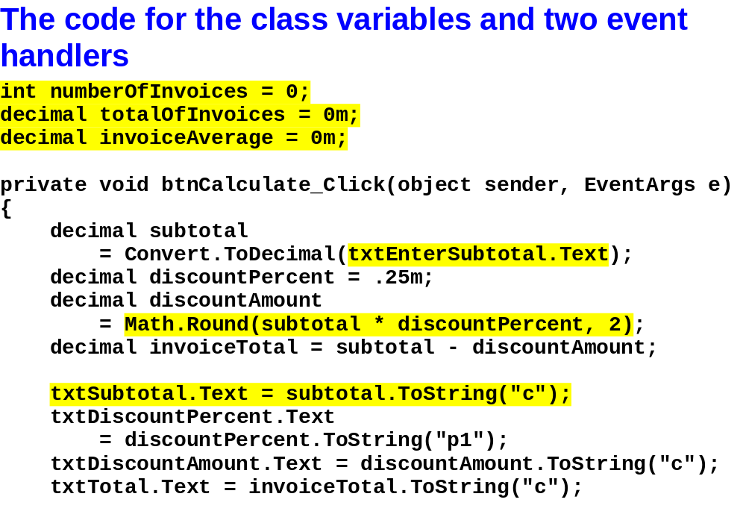
Murach’s C# 2010, C4
© 2010, Mike Murach & Associates, Inc.
Slide <number>

Slide 34
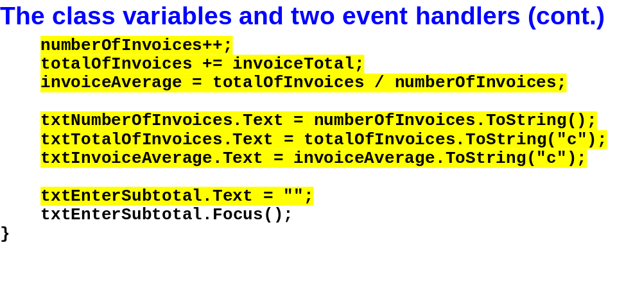
Murach’s C# 2010, C4
© 2010, Mike Murach & Associates, Inc.
Slide <number>

Slide 35
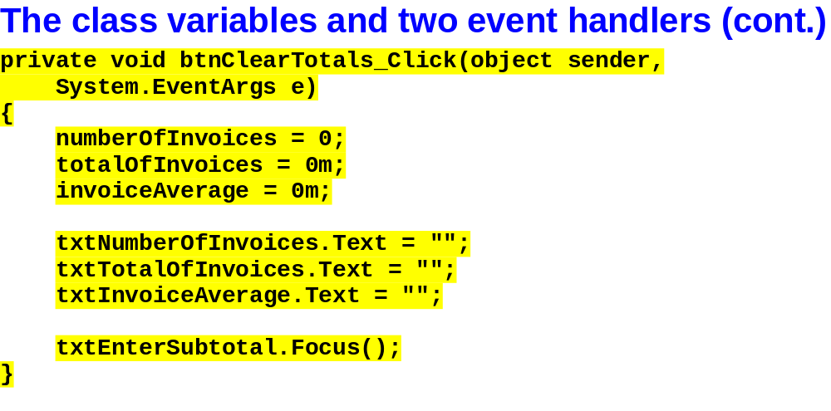
Murach’s C# 2010, C4
© 2010, Mike Murach & Associates, Inc.
Slide <number>

